Slide 1

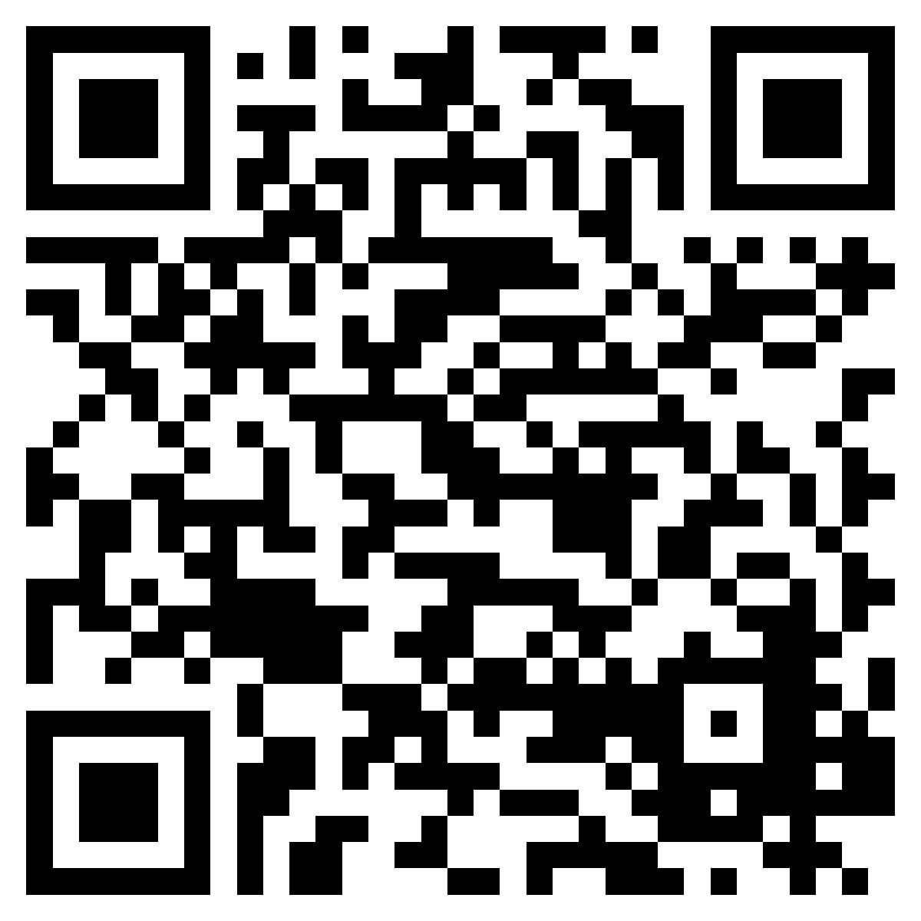

DARKA MARQUARDT
CHRO │ CPO │ CHIEF WORK OFFICER
+49 160 90143231
darka_marquardt@web.de
info@darkamarquardt-consultingservices.com
MEINE KENNTNISSE
End2End Employee Life Cycle + weitere anliegende Themen, die zum People Management gehören)
HR (People) Strategy
Workforce Strategy
Operating Model Design
Job Design
Employer Branding
Talent Attraction
Recruiting
Executive Search
Candidate Experience
Auswahl & Assessment
Einstellung (Hiring)
Onboarding
Begleitung der Probezeit
Talent Management
Performance Management
Learning & Development
Leadership Development
Nachfolgeplanung
Talentprogramme
Fast Track Programme
Karrierekonzepte
Interne Mobilität
Internationale Mobilität (Entsendung)
Skill & Kompetenz-Management
Offboarding
Alumni Management
Compensation & Benefits
Job Architecture (Grading)
Vergütungssysteme & Rewards
Executive Compensation
Payroll Outsourcing
Payroll (Gehaltsabrechnung)
Zeitwirtschaft
HR Operations
Employee Relations
Interne Kommunikation
Anerkennung & Recognition
Employee Engagement
Wellbeing
Diversity, Equity & Inclusion
Unternehmenskultur & Werte
Labour Relations (z.B. Tarif)
Zusammenarbeit mit Betriebsräten
HR Compliance
Arbeitsrecht
Global HR
Organisationsentwicklung
HR Governance
(Globale) Datenschutzlösungen
HR Risk Management
HR Shared Services
Strategisches Business Partnering
HR-Technologie, HR-IT-Landschaft & Strategie
HRIS Implementierungen (Workday, SAP SuccessFactors, Personio) inkl. Vertragswerk
Steuerung von HR-Dienstleistern & externen Partnern
People Analytics
KI im Personalmanagement & am Arbeitsplatz
Workforce Analytics
Workforce Cost Management
HR Budget- und Finanzplanung
Strategische Personalkostenplanung
Mergers & Acquisitions (People Due Diligence)
Post-Merger Integration
Restrukturierungen
Transformationen
Organizational Effectiveness
Future of Work: Kompetenzen heute & morgen
Produktivität
Aufbau neuer organisationaler Fähigkeiten
Krisenführung
Kulturtransformation
Change Management
Change Communication
Executive Leadership Advisory
Betreuung von Vorstand sowie
Vergütungs- und Personalausschüssen
Kommunikation mit Investoren
Corporate Governance
Ethics & Compliance

Slide 2

DARKA MARQUARDT
CHRO │ CPO │ CHIEF WORK OFFICER
+49 160 90143231
darka_marquardt@web.de
info@darkamarquardt-consultingservices.com
MY EXPERTISE
End-to-End Employee Lifecycle & the Full People Management Ecosystem
HR (People) Strategy
Workforce Strategy
Operating Model Design
Job Design
Employer Branding
Talent Attraction
Recruiting
Executive Search
Candidate Experience
Candidate Assessment & Selection
Hiring
Onboarding
Probationary Period
Talent Management
Performance Management
Learning & Development
Leadership Development
Succession
Talent Programs
Fast Track Programs
Carreer Framework Design
Internal Mobility
International Assignment
Skill & Competence Management
Offboarding
Alumni Management
Compensation & Benefits
Job Architecture (Grading)
Compensation & Rewards
Executive Compensation
Payroll Outsourcing
Payroll
Time & Absence
HR Operations
Employee Relations
Internal Communication
Appreciation & Recognition
Employee Engagement
Wellbeing
Diversity, Equity & Inclusion
Company Culture & Values
Labour Relations (z.B. Tariff)
Works Council(s)
HR Compliance
Labour Law
Global HR
OD = Organisational Development
HR Governance
(Global) Data Protection Solutions
HR Risk Management
HR Shared Services
Strategic Business Partnering
HR-Technology, HR-IT-Landscape & Strategy
HRIS Deployment (Workday, SAP SuccessFactors, Personio) incl. Contracting
Management of Solution Providers, external Partner & Parties in HR
People Analytics
AI in People Management & in the workplace
Workforce Analytics
Workforce Cost Management
HR Budget- und Finance Planning
Strategic Personnel Cost Planning
Mergers & Acquisitions (People Due Diligence)
Post-Merger Integration
Restructuring
Transformations
Organizational Effectiveness
Future of Work: Today & Future Skills
Productivity
Upskilling of the organisation
Leadership in crisis
Cultural Transformation
Change Management
Change Communication
Executive Leadership Advisory
Advising Executive Boards & Compensation Committees
Communication with Investors
Corporate Governance
Ethics & Compliance

